Slide 1

Verification of FIR filter

Slide 2
Contents
1- Introduction
2- Filter design
3- MATLAB Golden Model
4- FIR UVM environment
5- Project phases
6- DUT Results

Slide 3
Introduction
Filters are one of the most basic Building Blocks in DSP (whether it’s for an ASIC or to be used on FPGA), They are vital blocks in any system.
Mainly, A Filter is a LTI system that is used as a Signal Conditioning block which main role is to select the range of frequencies that will be either filtered out or allowed to pass through and it has 4 main types:
a) Low Pass Filter (LPF): allows frequencies that are below a certain threshold (Fc) to pass while attenuating above frequencies.
b) High Pass Filter (HPF): allows frequencies that are above a certain threshold (Fc) to pass while attenuating below frequencies.
c) Band Pass Filter (BPF): allows frequencies that are between two limits (Fc1 & Fc2) to pass while attenuating other frequencies.
d) Band Reject (Stop) Filter: attenuates frequencies that are between two limits (Fc1 & Fc2) while allowing other frequencies.

Slide 4
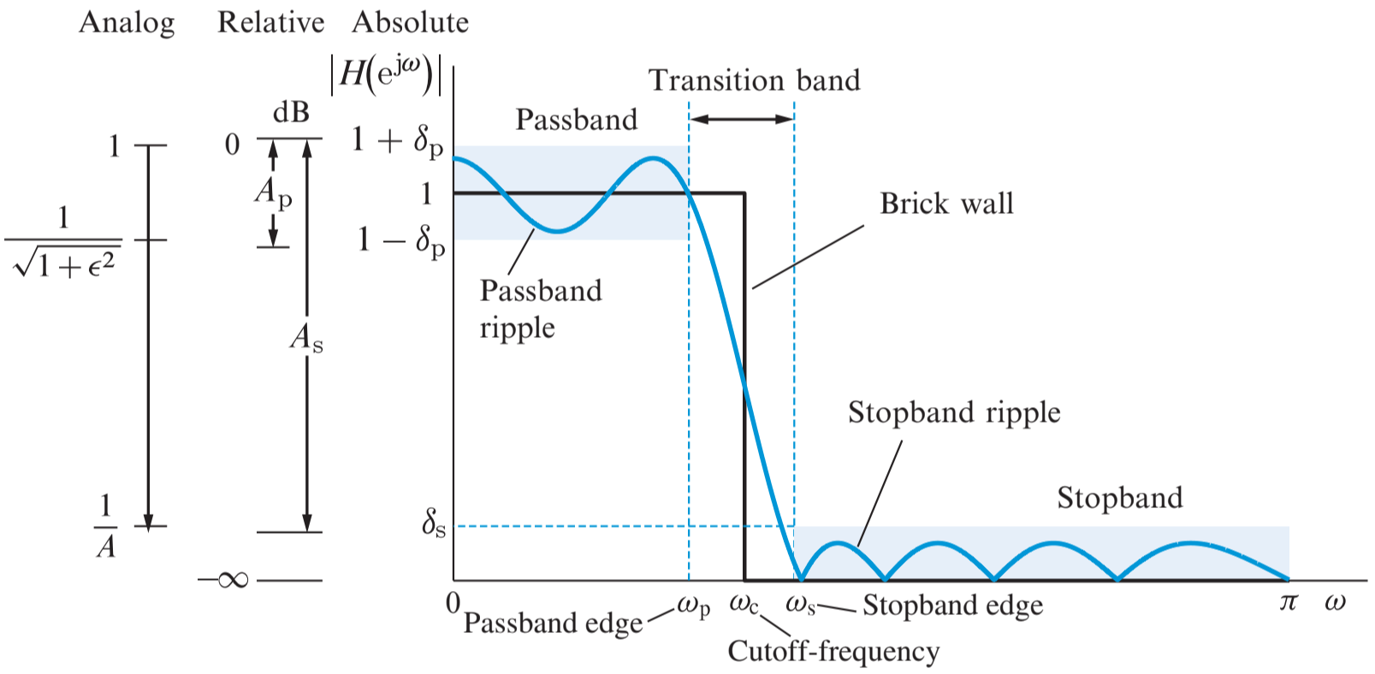
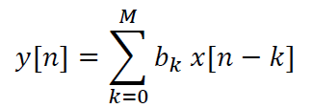
We will implement Lowpass FIR filter:
FIR filter is an Impulse response
that settles at zero after a finite
period of time, hence called a
Finite Impulse Response.
𝑥[𝑛−𝑘] : input sampled signal (discrete)
𝑦[𝑛] : The Filtered signal (FIR output)
𝑏𝑘 : Filter Coefficients, which equals the impulse response.

Slide 5
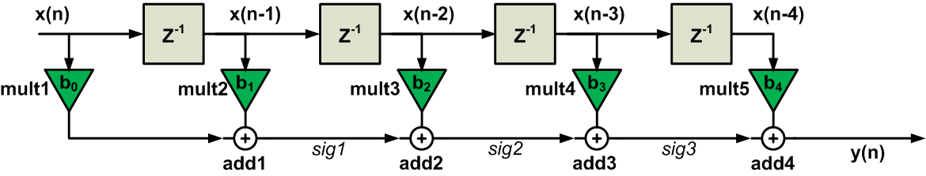
Filter Design
FIR Design will go by three main blocks:
1) Delay elements: represents the Z-transform block which will clock each samples delay properly.
2) Multipliers: for each of the taps coefficient values (impulse response) to be multiplied by the input samples.
3) Adders: The products from the multipliers are summed together to produce the filter's output.
A filter with N^{th} order will have (N) Z-transform blocks and adders, However It’ll have (N+1) multiplier taps.
for example: In the figure above, We have N adders & N circular buffers, (N+1) taps, so it’s 4th order filter.

Slide 6

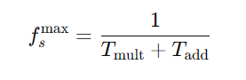
Transposed Vs. Direct Form filter
Critical Path = one mult. + N*adders where N equals FIR order
In this case:
(mult1 + add1 + add2 + add3 + add4)
Critical Path = one mult.+ one adder whatever the order of the FIR.
(mul5 + add4) in this case.

Slide 7
Choosing the Filter to be Designed:
We will design transposed filter that follow widowing method in designing our FIR Filter, and our chosen window will be hamming window, so our design parameters will go as follows:
A 50-order (51 taps) hamming FIR LPF Filter is to be designed with a cutoff frequency of 1 KHZ for a sampling frequency of 48 KHz.

Slide 8
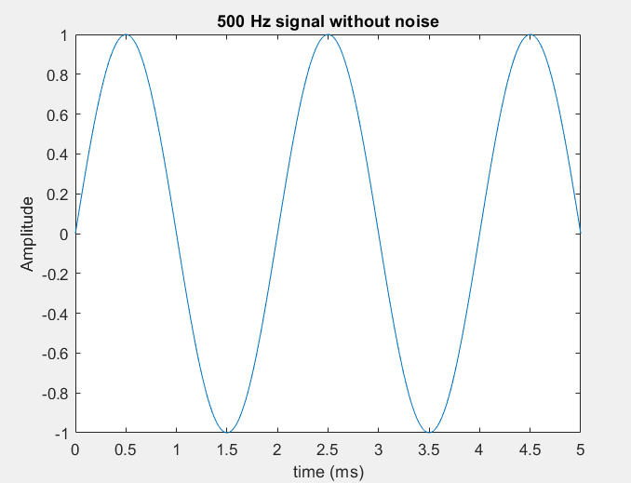
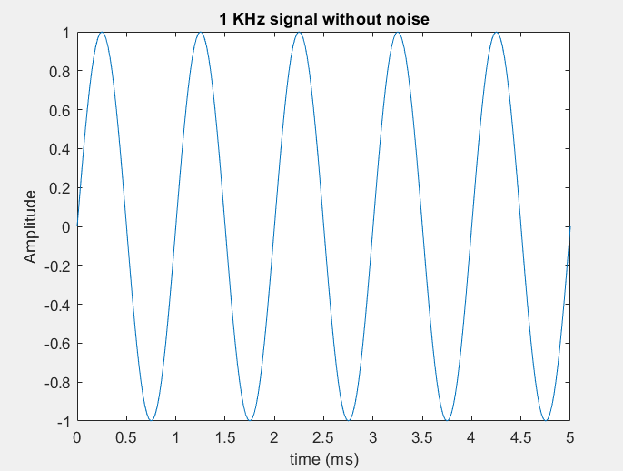
MATLAB Golden Model
Steps
1- Generate 3 sine waves of frequencies (500,1000,3000) Hz.

Slide 9
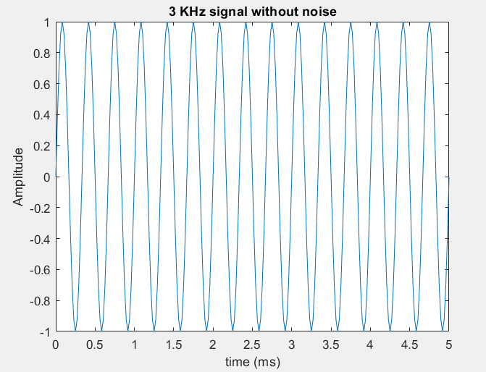
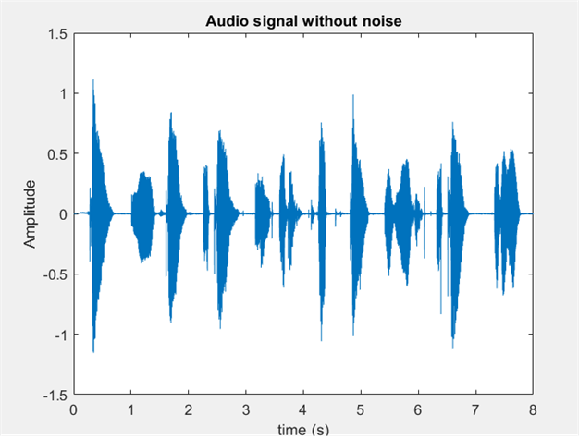
2- Read the audio recording file (can_recording.wav)
and convert it into signal points.
3- Choose 48 KHz sampling frequency as it’s more
than the twice the highest heared audio frequency,
so it’ll be suitable for both the audio & sine waves.

Slide 10
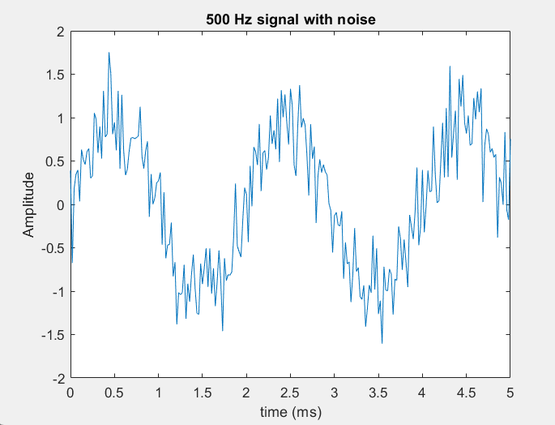
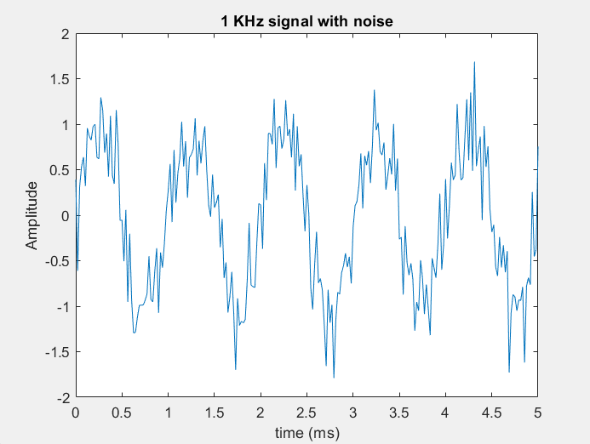
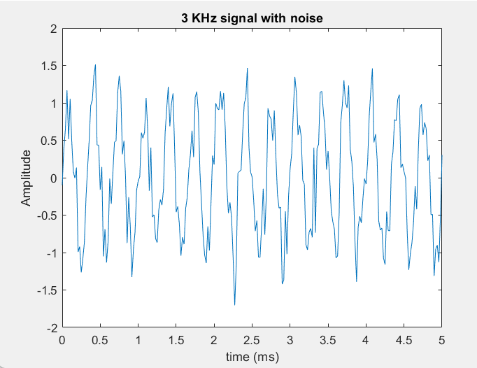
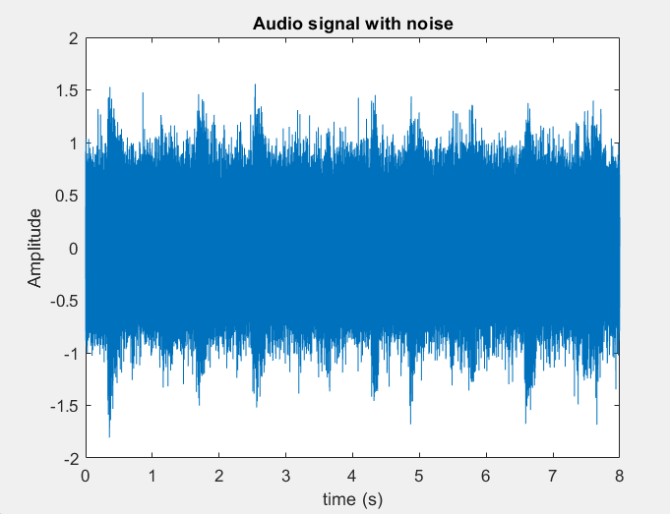
4- Add Additive white Gaussian noise (AWGN) to all the signals of mean equals zero and variance equals 0.09.

Slide 11
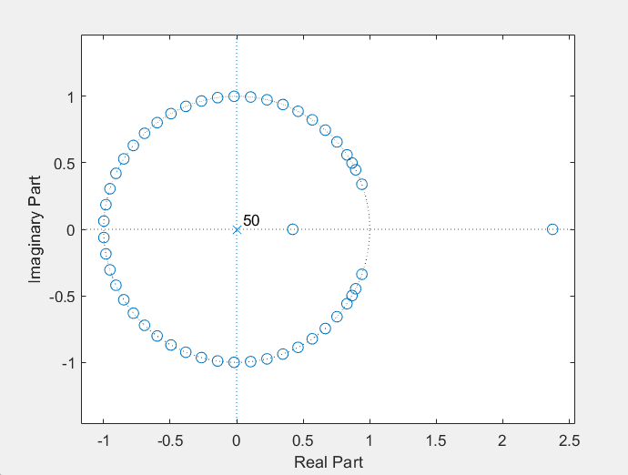
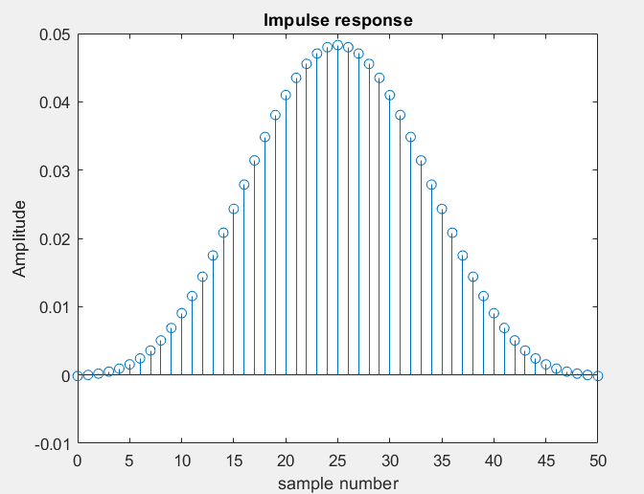
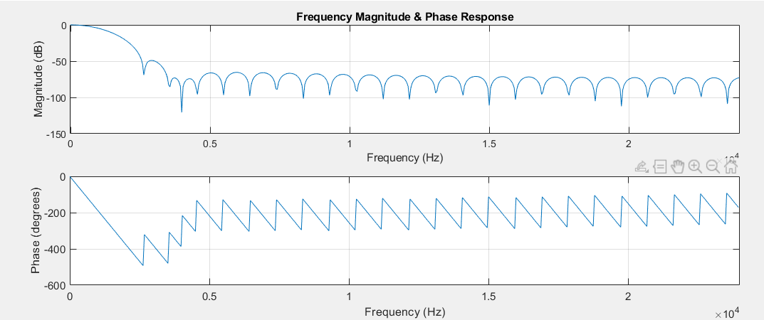
5- Write each input signals in form of fixed point in a separate txt file.
6- Generate filter coefficients according to the specs discussed before.

Slide 12
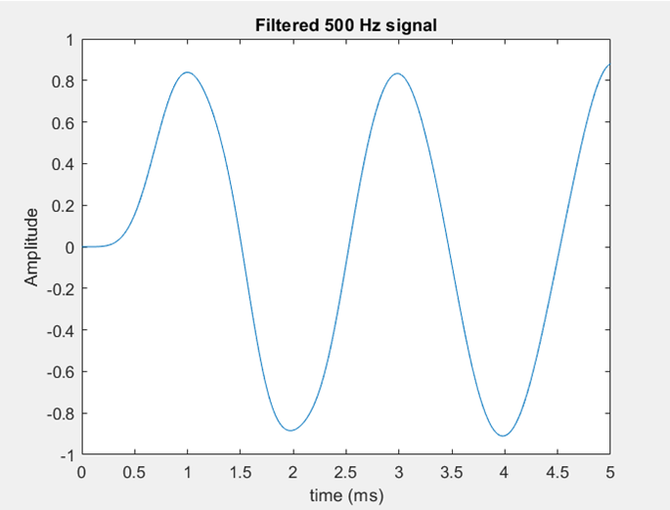
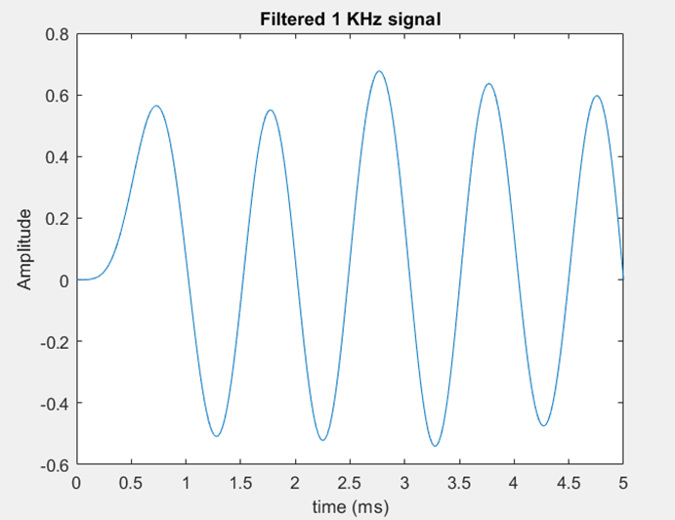
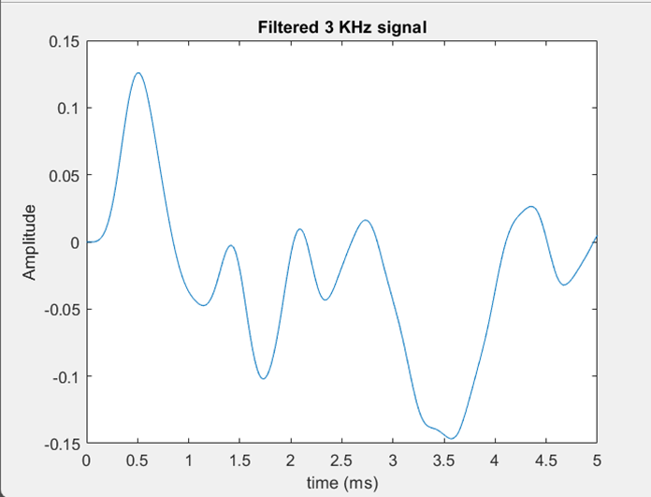
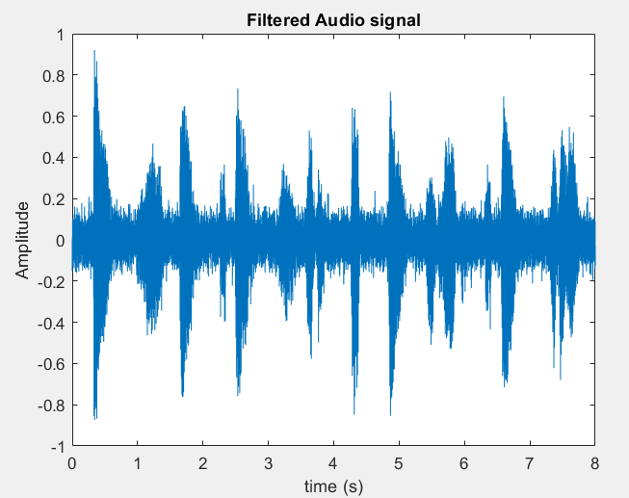
7- Apply the filter response to the 4 signals using (filter) function.

Slide 13
8- Write each output signal in fraction form in a separate txt file.
9- Write the audio signal in a wav file in order to hear it.
10- After running Questasim it’ll write the tested design signal in a txt file, Read it and write it in wav file, to can hear it.

Slide 14
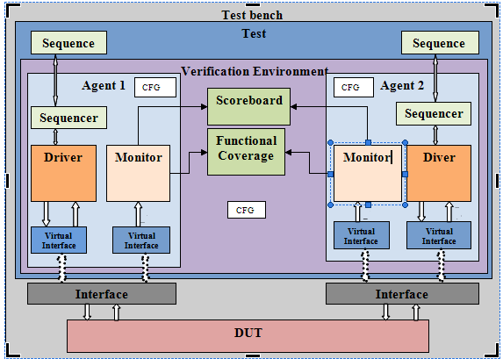
FIR UVM Environment
The figure on the right shows UVM
environment with 2 agents & 2
interfaces, but in our design we will
need only one agent & one interface
only.
UVM objects
1- Sequence item
Contains three main signals, noisy input, filtered output and reset.
Takes the noisy input signal points from txt file then store it in an array.
Also contain array for filtered signal, that will be used by Scoreboard & Coverage collector.
Constraint the reset to be always asserted

Slide 15
2- Sequence
Creates sequence item for reset assertion.
Creates 4 sequence items, each item read an input signal (disables randomization for all of them).
Sends the 4 sequence items to the sequencer and before each one, it sends the reset sequence item.
3- Configuration object
There’s 2 configuarion objects.
The First: Stores the virtual interface and gives it to the components that’ll use it.
The Second: Contains a variable used by the monitor to determine the first sequence item sent for delay purposes.
UVM Components:
1- Interface
Connects the DUT and the UVM environment.

Slide 16
2- DUT (Device Under Test)
The desired design need to be tested.
3- Test
Instantiates the environment
Controls the sequences and configurations.
Connects the coverage collector to the environment.
4- Environment
Instantiates the Agent, Scoreboard, and Coverage Collector.
Connects the DUT interface to the Agent.
5- Agent
Instantiate Sequencer, Driver, and Monitor.
Connects Sequencer & Driver with TLM.
Drives the interface signals to the DUT via the Driver.
Monitors the interface for outputs via the Monitor.

Slide 17
6- Sequencer
Drives the sequence to the Driver.
Sends sequence items to the Driver.
7- Driver
Loops on the input signal array sent within the sequence item and drives each point to the virtual interface along with rest.
8- Monitor
Collects the output filtered signal from the DUT in an array.
Encapsulates the filtered signal array & reset in a sequence then broadcast it to the Scoreboard & Coverage Collector.
9- Coverage collector
Receives sequence items from the monitor.
Performs functional coverage on inputs & outputs.

Slide 18
10- Scoreboard
Receives sequence items from the monitor
Reads the filtered signal from output file from MATLAB
Compares the filtered signal from DUT with the one MATLAB

Slide 19
Project phases
1- After building Questasim project named (FIR), Run (run_script.py) script.
2- The python script will open Matlab and run (Signal_Generation.m) script.
3- After Matlab finishes and you close Matlab, The python script will open FIR Questa project and run the do file (run.do).
3- The TCL commands in (run.do) will run the project, add waveforms and enable code coverage.
4- When Questa finishes simulation, it’ll produce code coverage report and write filtered audio signal in a txt file.
5- After you close Questasim, The script will open Matlab again and run (Generate_audio_dut.m) script.
6- The second Matlab script will take the filtered audio txt file and convert it into heared audio wav file.

Slide 20
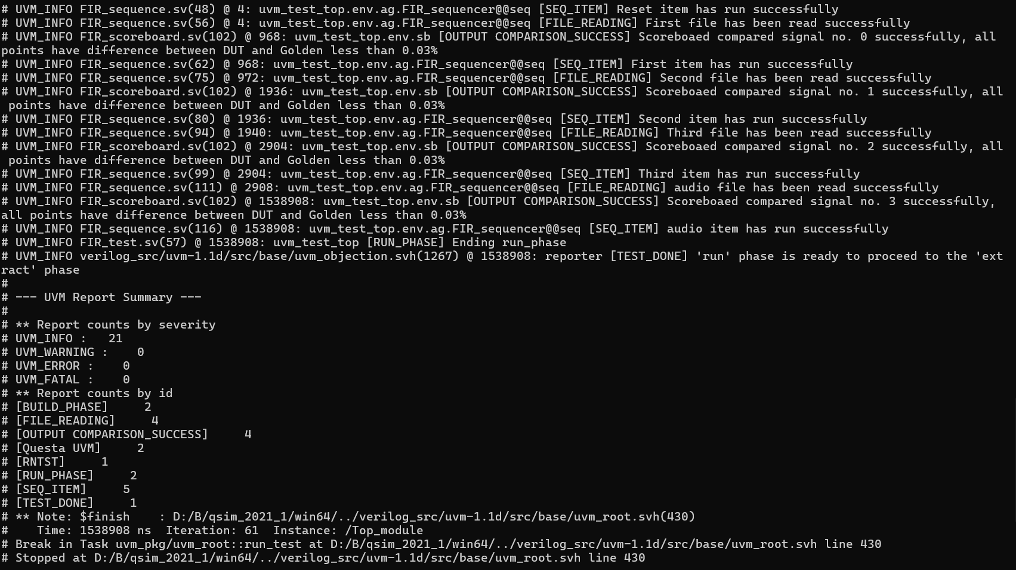
DUT Results
Transcript output

Slide 21


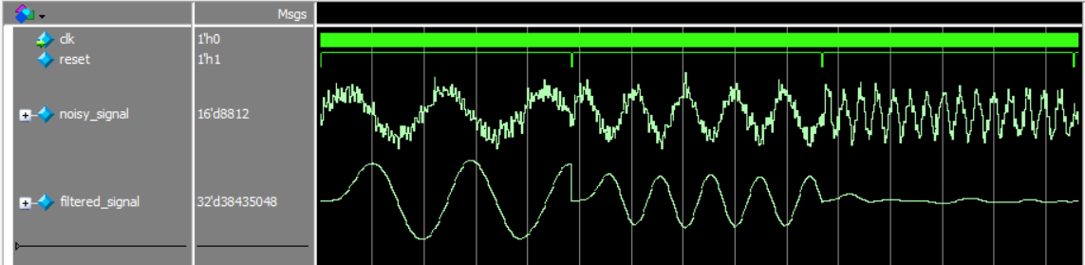
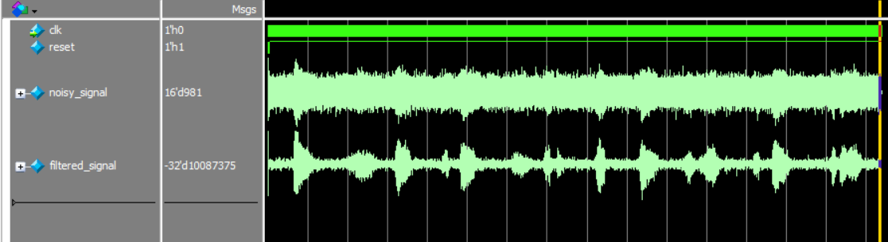
Functional coverage
Sine waveforms
Audio waveform
Code Coverage

Slide 22
Thank You
GITHUB: mwael2002
LinkedIN: Mohammad Wael

